Slide 1


<Name>
<Date>

Slide 2

Outline
Executive Summary
Introduction
Methodology
Results
Conclusion
Appendix

Slide 3
Executive Summary
- Methodologies: Collection via SpaceX API and scraping, wrangling, EDA with visualization and SQL, interactive visual analytics with Folium and Plotly Dash, prediction with classification models.
- Results: Success varies by site, orbit, payload; best model with 83% accuracy.

Slide 4
Introduction
- Background: Predict Falcon 9 first stage landing success to reduce costs.
- Problems: Factors influencing landing success.

Slide 5

Section 1

Slide 6
Methodology
Executive Summary
Data collection methodology:
Describe how data was collected
Perform data wrangling
Describe how data was processed
Perform exploratory data analysis (EDA) using visualization and SQL
Perform interactive visual analytics using Folium and Plotly Dash
Perform predictive analysis using classification models
How to build, tune, evaluate classification models

Slide 7
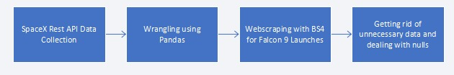
Data Collection
Data was gathered from the open-source SpaceX REST API, which provides information on rocket launches, cores, and other details. To expand the dataset, I scraped Wikipedia for additional data on Falcon 9 launches and processed it to create a pandas DataFrame, removing any rows with missing values or those related to Falcon 1 (since it lacks a reusable first stage).

Slide 8
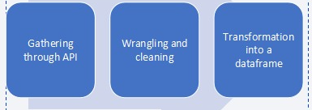
Data Collection – SpaceX API
Using custom get_ functions, I retrieved data on rockets, launch sites, and other attributes, which were then relabeled and organized into a DataFrame.
https://github.com/MatildeCruzz/ibm-projects/blob/14285b7c5839c2f48604c3e3f4d6fd7b0f53b9ff/jupyter-labs-spacex-data-collection-api.ipynb
Place your flowchart of SpaceX API calls here

Slide 9
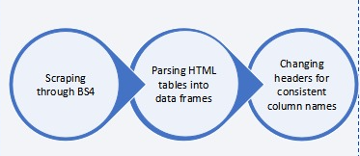
Data Collection - Scraping
The data was extracted using BeautifulSoup (BS4) to scrape HTML tables from Wikipedia, which were then converted into pandas DataFrames with standardized and consistent column headers.
https://github.com/MatildeCruzz/ibm-projects/blob/14285b7c5839c2f48604c3e3f4d6fd7b0f53b9ff/jupyter-labs-webscraping.ipynb
Place your flowchart of web scraping here

Slide 10
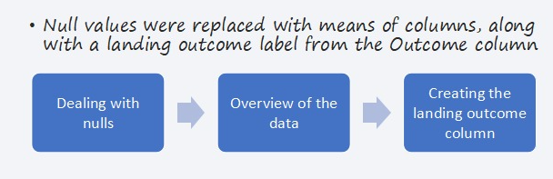
Data Wrangling
https://github.com/MatildeCruzz/ibm-projects/blob/14285b7c5839c2f48604c3e3f4d6fd7b0f53b9ff/labs-jupyter-spacex-Data%20wrangling.ipynb

Slide 11
EDA with Data Visualization
For analysis, I used Seaborn’s catplot with the class as the hue to visualize various data points. For categorical data like orbit type, I used bar plots, while the success rate over time was visualized as a line chart for clearer interpretation.
https://github.com/MatildeCruzz/ibm-projects/blob/8d5fbea22dba112d8760c639ad56e96e3f306c82/edadataviz%20(1).ipynb

Slide 12
EDA with SQL
I performed the following analyses on the dataset:
Listed all unique launch sites used for Falcon 9 launches.
Displayed five records for launches from sites starting with ‘CCA’ (e.g., Cape Canaveral).
Calculated the total payload mass for boosters launched under NASA missions.
Determined the average payload mass for launches using the Falcon 9 v1.1 booster version.
Identified the date of the first successful landing of a Falcon 9 booster.
Listed the names of boosters that achieved successful drone ship landings and carried payloads with masses between 4,000 and 6,000 kg.
Counted the total number of successful and failed mission outcomes.
Identified all booster versions that carried the maximum payload mass recorded in the dataset.
Listed boosters that failed to land on drone ships in 2015, including their launch site and the month of the attempt.
Ranked the frequency of different landing outcomes (e.g., success, failure) for launches between June 4, 2010, and March 20, 2017.
https://github.com/MatildeCruzz/ibm-projects/blob/8d5fbea22dba112d8760c639ad56e96e3f306c82/jupyter-labs-eda-sql-coursera_sqllite%20(1).ipynb

Slide 13
Build an Interactive Map with Folium
I created an interactive map by first adding circular markers to indicate the locations of launch sites. Then, I placed individual markers at each site, customizing their icons to reflect different colors based on the success rate of launches from those sites. I also drew lines connecting each launch site to the nearest coastline, as well as to nearby highways, railways, and the central points of cities where the launch sites are located, to provide geographic context.
https://github.com/MatildeCruzz/ibm-projects/blob/ce9944d8a185d366b41a1f01904b100288a2db64/lab_jupyter_launch_site_location%20(1).ipynb

Slide 14
Build a Dashboard with Plotly Dash
Summarize what plots/graphs and interactions you have added to a dashboard
Explain why you added those plots and interactions
Add the GitHub URL of your completed Plotly Dash lab, as an external reference and peer-review purpose

Slide 15
Predictive Analysis (Classification)
I used the scikit-learn library to develop predictive models, evaluating their performance using the best_params_ and best_score_ attributes to measure accuracy. I experimented with multiple approaches, including logistic regression and grid search, but found that the decision tree classifier provided the highest accuracy.
https://github.com/HadiFaheemFarooqi/ibm-capstone-labs/blob/5e813788384687346267071233c1544a4627c2bf/SpaceX_Machine%20Learning%20Prediction_Part_5.ipynb

Slide 16
Results
As the years progressed, the success rate of Falcon 9 launches improved. In Low Earth Orbit (LEO), the number of flights appeared to positively influence the success rate, suggesting that more launches led to better outcomes. However, in Geostationary Transfer Orbit (GTO), no clear relationship between flight frequency and success was observed, likely due to the complexity of these missions.
For the interactive analytics demo, screenshots were provided to showcase the visualizations and model results. The dataset included only 18 test samples, and the decision tree classifier achieved the highest accuracy of 83%, making it the best-performing model for predicting landing outcomes.

Slide 17

Section 2

Slide 18
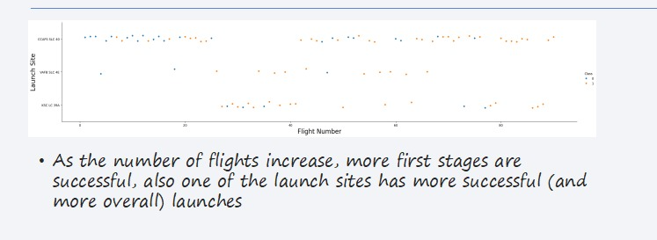
Flight Number vs. Launch Site

Slide 19
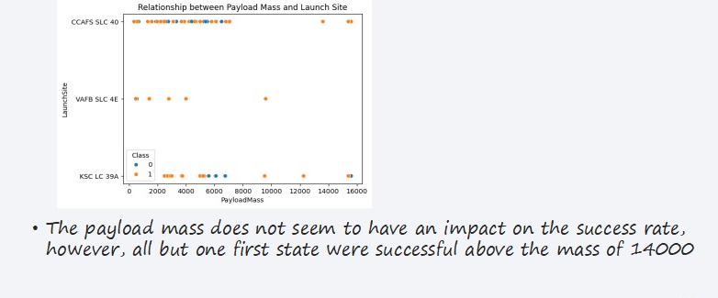
Payload vs. Launch Site

Slide 20
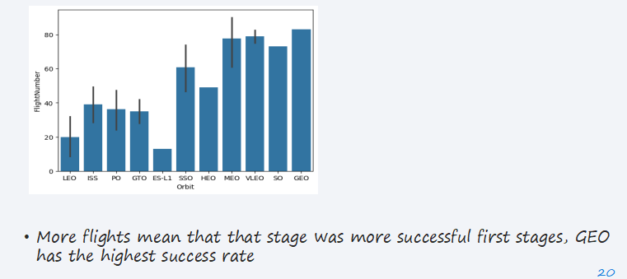
Success Rate vs. Orbit Type

Slide 21
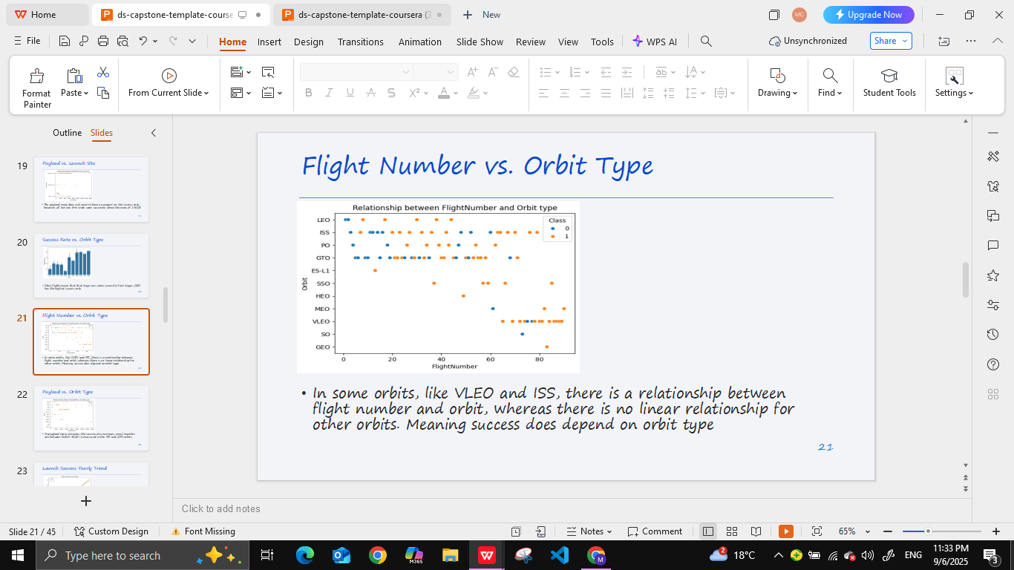
Flight Number vs. Orbit Type

Slide 22
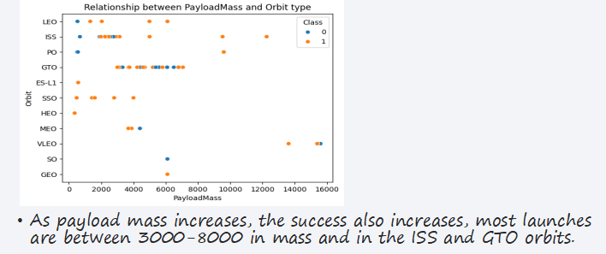
Payload vs. Orbit Type

Slide 23
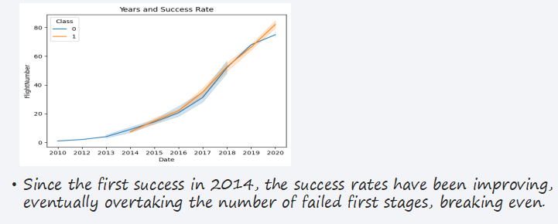
Launch Success Yearly Trend

Slide 24
All Launch Site Names
-CCAFS LC-40
-VAFB SLC-4E
-KSC LC-39A
-CCAFS SLC-40
These are the names of the different launch sites in this data frame, which I calculated with the SQL queries.

Slide 25
Launch Site Names Begin with 'CCA'
-CCAFS LC-40
-CCAFS LC-40
-CCAFS LC-40
-CCAFS LC-40
-CCAFS LC-40
These are the first 5 launch sites with the name beginning with CCA .

Slide 26
Total Payload Mass
619967
This, in kilograms, is the total mass of the payloads that were launched by NASA

Slide 27
Average Payload Mass by F9 v1.1
2928.4
This in kg is the average mass of payloads launched with the booster version F9 v1.1

Slide 28
First Successful Ground Landing Date
2015-12-22
As seen in the earlier success rate graph, 2015 is the year of the first successful outcome, more specifically the 22nd of December

Slide 29
Successful Drone Ship Landing with Payload between 4000 and 6000
F9 FT B1022
F9 FT B1026
F9 FT B1021.2
F9 FT B1031.2
These are the boosters that have had success with drone ship and had a payload in the range of 4000 to 6000 kgs

Slide 30
Total Number of Successful and Failure Mission Outcomes
There were 100 successful and 1 unsuccessful mission outcomes, calculated through the Mission Outcome column.

Slide 31
Boosters Carried Maximum Payload
F9 B5 B1048.4, F9 B5 B1049.4, F9 B5 B1051.3, F9 B5 B1056.4,
F9 B5 B1048.5, F9 B5 B1051.4, F9 B5 B1049.5,
F9 B5 B1060.2, F9 B5 B1058.3, F9 B5 B1051.6,
F9 B5 B1060.3, F9 B5 B1049.7
These are the names of all the boosters that have carried the maximum payload

Slide 32
2015 Launch Records
F9 v1.1 B1012, F9 v1.1 B1015, F9 v1.1 B1017, F9 FT B1020, F9 FT B1024
These are all boosters which failed with a drone ship, this list is different from those which did not make an attempt with the drone ship or landed through other means

Slide 33
Rank Landing Outcomes Between 2010-06-04 and 2017-03-20
No attempt 10
Failure (drone ship) 5
Success (drone ship) 5
Controlled (ocean) 3
Success (ground pad) 3
Failure (parachute) 2
Uncontrolled (ocean) 2
Precluded (drone ship) 1
These are all the landing outcomes between the two dates, as shown, most times there was no attempt to land, or there was a failure to do so with a drone ship

Slide 34

Section 3

Slide 35
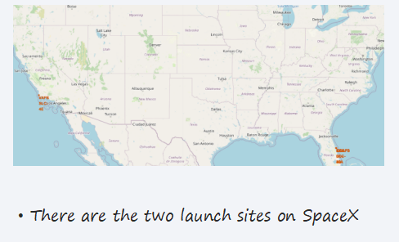
<Folium Map Screenshot 1>

Slide 36
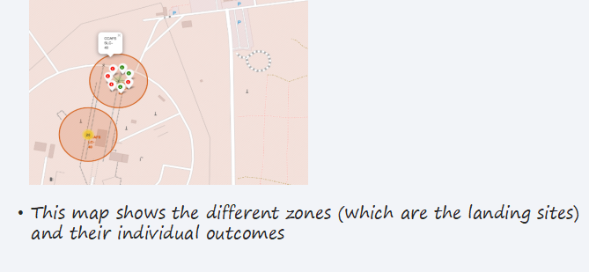
<Folium Map Screenshot 2>

Slide 37
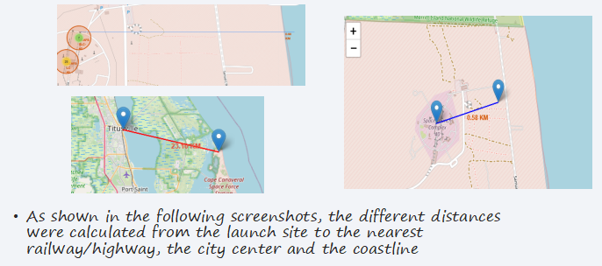
<Folium Map Screenshot 3>

Slide 38

Section 4

Slide 39
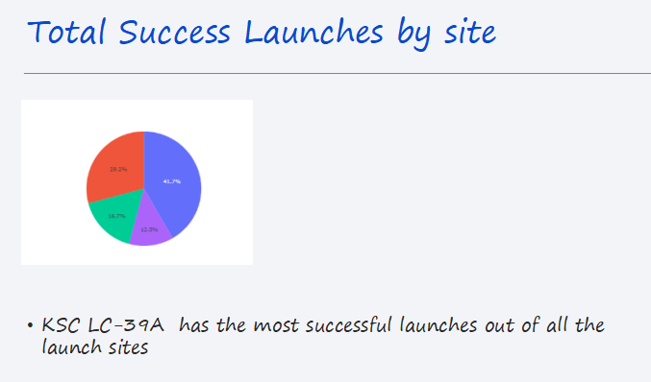

Slide 40
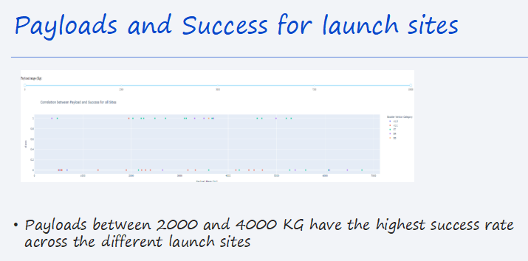

Slide 41

Section 5

Slide 42
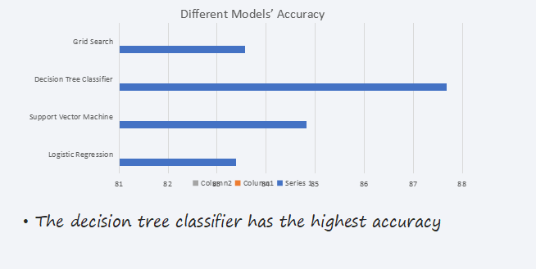
Classification Accuracy

Slide 43
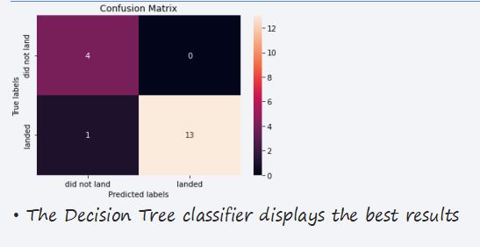
Confusion Matrix

Slide 44
Conclusions
In conclusion, the project involved analyzing Falcon 9 data from SpaceX API and Wikipedia, forming a clean pandas DataFrame without incomplete or Falcon 1 entries. Structured data with custom functions and BeautifulSoup. Visualized via interactive map (success-rate markers, lines to coastlines), Seaborn catplots, bar plots (orbits), and line chart (LEO success trends). Decision tree classifier achieved 83% landing prediction accuracy, highlighting SpaceX’s reusability progress. Basically, doing all the stels in the life cycle of data science.

Slide 45


